Slide 1
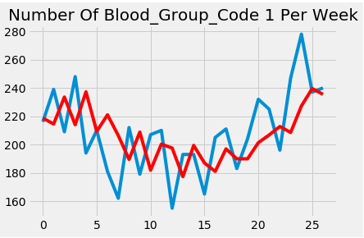
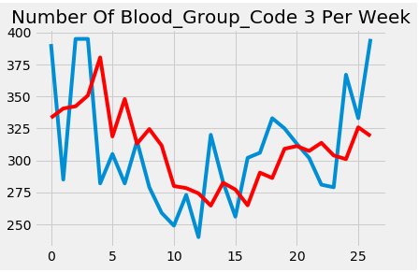
Business Use Case # 1
If we are predicting the amount of particular blood group donations for the upcoming weeks, we can ask the hospitals to contact our Blood bank if they need that blood group in those weeks.

Slide 2
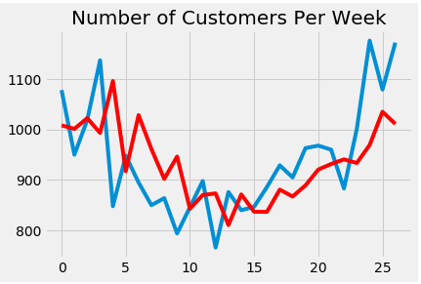
Business Use Case # 2
Pooling of resources i.e. by analysis of data we can distribute our blood bank resources accordingly among various branches

Slide 3

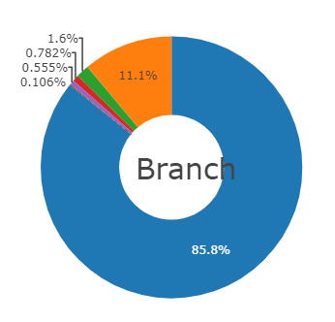
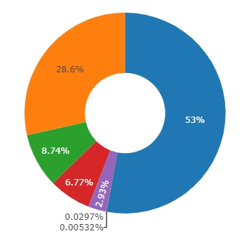



Slide 4
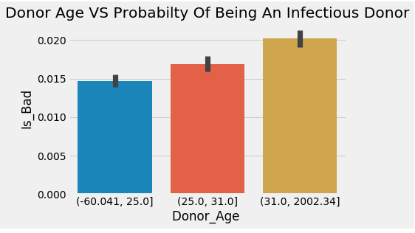
Business Use Case # 3
By knowing the vital signs and inexpensive test results we can predict about the possibility of an infection in a blood sample. This will not only save time but also save money by avoiding expensive tests.

Slide 5
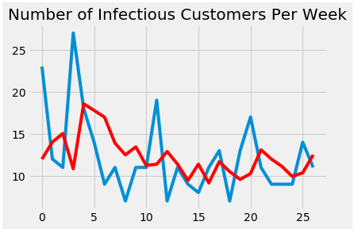
Business Use Case # 4
By predicting the total number of bad donors in the upcoming week, We can decrease the number of expensive tests applied on all the samples and rely more on our classification algorithm

